Slide 1
Automatic Identification of Chiasmus
A Computational Approach

Slide 2
Introduction to the Book of Helaman
A The Book of Helaman, an account of the Nephites. Their wars and contentions, and contentions, and their dissensions. And also the prophecies of many holy prophets, before the coming of Christ.
B According to the records of Helaman, who was the son of Helaman, and also according to the records of his sons, even down to the coming of Christ.
C1 And also many of the Lamanites are converted.
C1 An account of their conversion.
C2 An account of the righteousness of the Lamanites,
C2 and the wickedness and abominations of the Nephites,
B According to the record of Helaman and his sons, even down to the coming of Christ,
A Which is called the book of Helaman, and so forth.

Slide 3
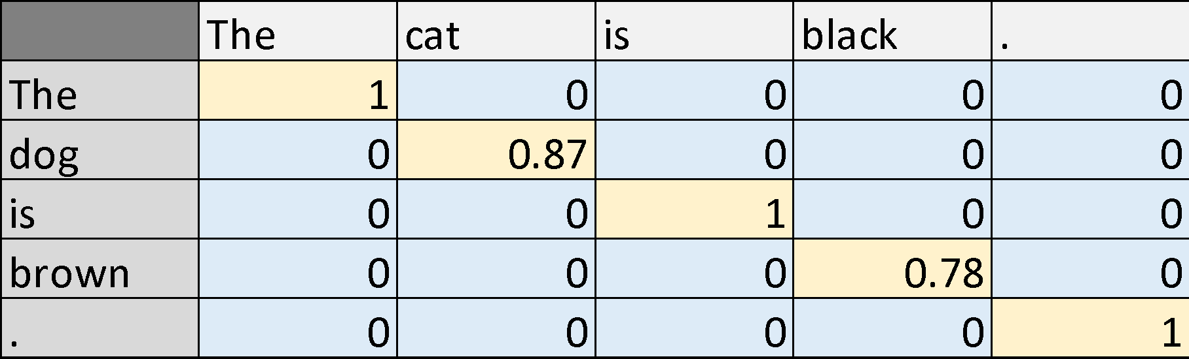
Similarity Matrix
Semantically similar
words (words with
similar meanings) can
have similarity scores
between 0 and 1.

Slide 4
How it works
Take the Similarity matrix of the same phrase along the top and the side.
Zero out the main diagonal.
Examine the trends that remain.

Slide 5
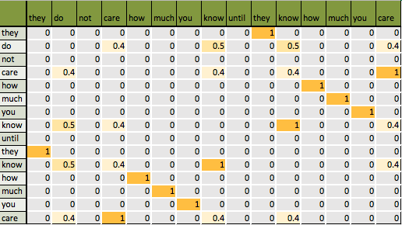

Slide 6
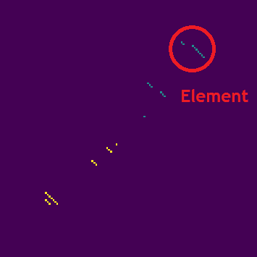
What Does a Chiasmus Look Like in a Similarity Matrix?
Chiastic elements are diagonal trends that go down and to the right.
Chiasmus are diagonal trends of chiastic elements that go down and to the left.

Slide 7
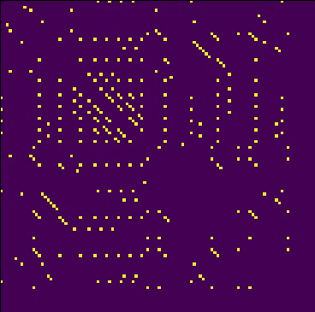
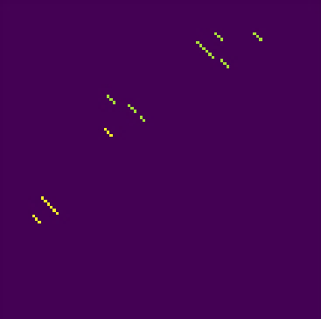
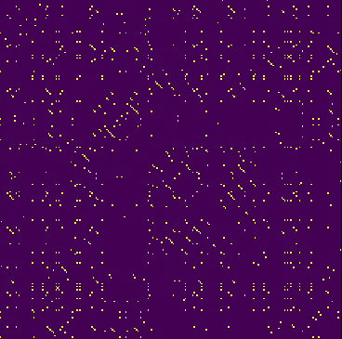
What Does a Chiasmus Look Like in a Similarity Matrix?
Mosiah 3:5-6

Slide 8
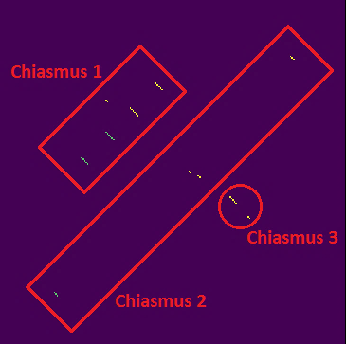
What Does a Chiasmus Look Like in a Similarity Matrix?
1 Ne 1:15-18

Slide 9
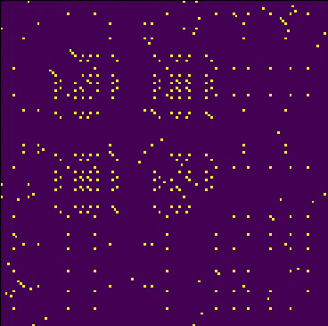
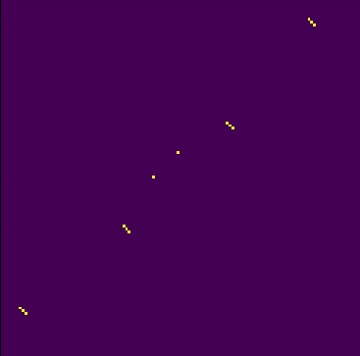
What Does a Chiasmus Look Like in a Similarity Matrix?
Eph 2: 1-10

Slide 10
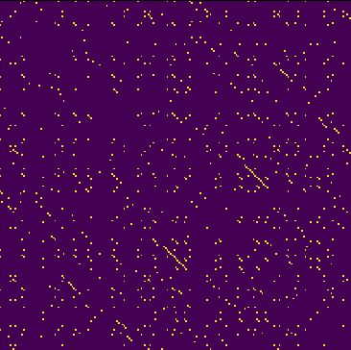
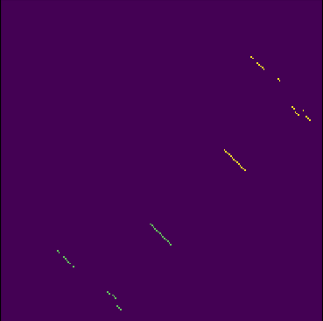
What Does a Chiasmus Look Like in a Similarity Matrix?
Eph 2: 1-10

Slide 11
Future Plans
Will run all of the known Near Eastern texts.
We plan to submit our results for publication soon.
Calculating probability of being intentional using Weighted Pearson Correlation Coefficient.

